Slide 1
CSC 307- NET-CENTRIC COMPUTING
LECTURE SERIES 1 2021
TUTOR: DR.(MRS.) F.A OLADEJI
DEPARTMENT OF COMPUTER SCIENCES, UNIVERSITY OF LAGOS
foladeji@unilag.edu,ng
07033629809
Room 106 Computer Science Building
Faculty of Science

Slide 2
Grading system
Continuous assessment 30%
Assignments and Lab work 20 marks
Mid-Semester Test 10 marks
End-Semester Exam 70 marks
Textbook:

Slide 3
Text Books
Computer networks and Internet by Douglas Comer, 5th edition or higher

Slide 4
CONTENTS:
-Intro to computer networks: edge- client, network edge, server programs, network core
-protocol layers and their service models: application layer & applications services
-socket programming with tcp, udp
-transport layer- services, models
-network layer- packet forwarding, routing, addresses, models
-Link layer- LANs, wireless, mobile networks, cloud computing
-multimedia networking
-network security chp
-network management
-compression techniques
-Test & revision

Slide 5
Concepts
Computer network refers to the interconnection of two or more computer systems using data communication devices. In other words, the interconnection of stand-alone computers using networking media and devices.
The computer network was developed to solve some inherent problems associated with stand-alone computers such as resource sharing and inter-system communication and collaboration.
The resources that can be shared include: data, messages, graphics, printers, fax machine, modems, and other peripheral devices.
Therefore, a computer network enhances resource sharing, fosters interdepartmental communication and coordination thus leading to increased performance and productivity as well as a decrease in procurement cost.

Slide 6
Computer network or data communication

Slide 7
A sample network

Slide 8
Use of Hub/switch

Slide 9
WAN

Slide 10
Wireless Network

Slide 11
Wireless and wired interconnection

Slide 12
Computer networks: Wired vs Wireless
The distinction between these types of network is based on the medium of connection, that is, the interconnectivity device used.
A wired network is a network where cables are used to physically interconnect the systems together. Therefore to setup a wired network requires the following:
1 PCs
2 Network Interface Card (NIC)
3 Network Operating System (NOS)
4 Cable
Wireless network on the other hand, refers to a network that is devoid of cables to physically establish a link, but rather radio waves are used as the medium of interconnection

Slide 13
There are basically two types of node in a network.
They are:
Peer-to-Peer network node
Client/Server network node

Slide 14
Peer-to-Peer Network
This is the simplest form of network that is generally preferable when the number of systems involved is few.
With this approach, each computer acts as a workstation (client) and as server (repository of resources). That is there are no master and no slave.
Data and resources are distributed throughout the network with no central server maintaining all the resources of the systems.
Although Peer-to-Peer is very simple and in expensive, it is usually not be the best choice for large organization. Lack of centralized control and administration makes it difficult to manage.

Slide 15
Peer-to-Peer Network…
Each workstation (client) has a password and a user must know the password of a particular system before use.
Similarly, each user must be trained on how to share resources on the system thus making the user a local system administrator of each of the systems.
Security in Peer-to-Peer is weak. Since there is no central server, each user is responsible for authenticating access to data, so that unauthorized users are prevented.
It uses what is referred to as share-level security which necessitates that a user knows the password for a resource before use.
Advantages
1 It is cheap to setup.
2 It is easy to install/setup.
3 It is easy to maintain.

Slide 16
Peer-to-Peer Network
Disadvantages
1 It has weak security.
2 It requires no centralized administration/control.
3 It requires training for users to acts as users and administrators.
4 Resources such as data are distributed on all workstations and it is difficult locating a particular resource.
5 Backup is done on all workstations.
Peer-to-Peer Network Operating Systems
i. Linux
ii. Windows 98, XP, NT for workstation, 2000 Professional and 2003

Slide 17
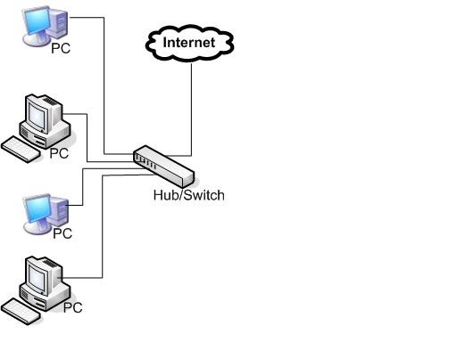
Peer-to-Peer Network Cont’d
Fig. 1 Peer-to-Peer Network

Slide 18
Client/Server Network
In a client-server or server-based network, there is at least one system designated as the server.
The server has a higher processor, larger storage and larger memory than the client and is responsible for performing all administrative functions as well as centrally managing and controlling the resources of every user of the network.
All other systems beside the server are referred to as clients. The clients store their files on the server and request for resources from the server. Generally clients are of lesser capacities than the server in terms of processing speed, storage and memory. Hence they are less expensive.

Slide 19
Client/Server Network
In this arrangement, nobody works on the server, it is dedicated for file serving, management and control.
Hence it is ideal for a situation where there are more than ten (10) systems and all systems but one are clients and are available for use by users but only the network administrator works on the server.
The server being a repository all the files on the network, security is granted to user based on his account on the server and this is called user-level security. There is effective control and management. Backup is done only on the server.
There can be more than one server on a particular network. Each one of them has specialized function to perform thus leading to what can be termed division-of-labour, load-balancing and specialization.

Slide 20
Server Based Network
Possible servers can be:
File and Print Servers
The file server is responsible for managing user access to the server as well as file storage and usage. The print server on the other hand is responsible for print services.
Mail Servers
These are responsible for managing e-mail messages among users.
Fax Servers
These servers manage the inflow and outflow of fax traffic by sharing one or more fax modem boards.

Slide 21
Server Based Network – Cont’d
Application Servers
These servers house the entire databases for the organization from which client applications make requests. Rather than the entire databases being transferred to the client, only the result of the query is passed to the client. This describes in vivid terms what happens in client-server computing.
Directory Services Servers
These servers are responsible for aiding users to locate, store and secure information.
Communication Servers
These servers manage data and information flow (e-mail) between two networks.

Slide 22
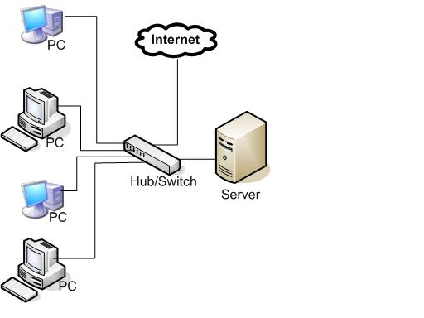
Server Based Network – Cont’d
Fig.2 Server-Based Network

Slide 23
Server Based Network – Cont’d
Advantages of Client-Server Networks
1 It offers centralized security and control.
2 It offers ease of backup.
3 There is no duplication of resources.
4 A user needs only his password to logon to the system.
Disadvantages of Client-Server Network
1 There is increased cost because of the inclusion of a server.
2 It is prone to failure if the server is down.
3 It requires a dedicated administrator.

Slide 24
Factors Considered in Setting up a Network
Basically, the general considerations needed before deciding on the types of network include the:
Size of the organization Amount of traffic
Level of security Level of administrative support
Types of business Cost
Users’ needs
In summary, the size of an organization can influence the choice of a Peer-to-Peer. If the computer processing needs may not exceed ten systems then it can be chosen because all the workstations are usable and if it were to be a server-based network one of then would be reserved for centralized control and administration.

Slide 25
CATEGORIES OF NETWORKS
Computer network can be categorized into three, based on geographical coverage:
1 Personal Area Network
2 Local Area Network (LAN)
3 Metropolitan Area Network (MAN)
4 Wide Area Network (WAN)

Slide 26
CATEGORIES OF NETWORKS
1. Personal Area Network
This is a sub-category of LAN. It is composed usually of personal devices such as mobile phones, PDAs, digital camera, MP players etc. that are wirelessly connected together using the Bluetooth.
Characteristics of PAN
a. It connects usually wireless personal mobile devices
b. It usually involves the Bluetooth
c. It is usually formed within vicinity (a room)

Slide 27
CATEGORIES OF NETWORKS – Cont’d
2. Local Area Network
This is the smallest network unit contained within a geographically clustered area. This is a network within a building, office or blocks of buildings in the same vicinity or a University Campus.
Characteristics of LAN
It covers small areas (an office)
It has high transmission speed
c. It is less expensive
d. It is prone to very few errors

Slide 28
CATEGORIES OF NETWORKS - Cont’d
3. Metropolitan Area Network
MAN is a group of networks within a metropolis. That is, the collection of LANs within a metropolitan city. This can be a network linking a multi-campus university spread over a metropolitan city.
Characteristics of MAN
a. It is larger than LAN (within a metropolis)
b. It has lower transmission speed than LAN but faster than WAN
c. It is more expensive than LAN
It is prone more errors than LAN

Slide 29
CATEGORIES OF NETWORKS – Cont’d
4. Wide Area Network
WAN is a network within geographically dispersed area. This refers to the interconnection of LANs and MANs across cities, states and country or countries.
Characteristics of WAN
a. It is the largest network (Nation Wide)
b. It has slower transmission speed than MAN
c. It is more expensive than MAN
d. It has the highest error rate

Slide 30
NETWORKS TOPOLOGIES
Network topology simply means the arrangement of computers, cables and other components of the network.
Topologies are classified into two:
Physical Topology and Logical Topology.
The physical topology refers to the physical layout of cables and the other physical components,
The logical topology refers to the way messages are passed from one node to another.

Slide 31
NETWORKS TOPOLOGIES
There are five network topologies.
They are:
1. Bus
2. Star
3. Ring
4. Mesh
5. Hybrid

Slide 32
BUS TOPOLOGY
1. Bus Topology
This is the simplest physical topology. It is otherwise referred to as a linear bus.
In this topology all the computers are connected to a single cable called trunk or backbone.
It uses the least amount of cables since the backbone runs from the first workstation to the last and other systems are connected at specified locations or offices.
Communication among the systems on the network is through the trunk.
Advantages
It uses less cable.
It requires less expensive equipment.
It is simple to install and configure.
It can easily be expanded using connectivity devices.
Failure of a workstation does not affect the network.

Slide 33
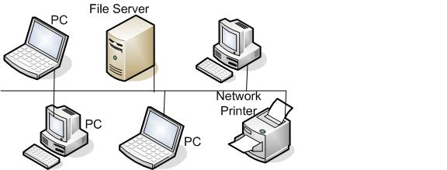
BUS TOPOLOGY
Disadvantages
The connectors used weaken the signals.
Troubleshooting the network can be problematic; the entire network must be diagnosed.
Its performance is based on the number of workstations.
It is expensive to maintain.
Cable breaks affect the entire network.

Slide 34
STAR TOPOLOGY
2. Star Topology
In a star topology, each workstation is connected to a central device called a hub, through a separate cable.
The hub comes in different sizes with 8, 16, 24, 32 ports. This makes it easier to expand the network by replacing the hub with another one or by cascading the old and the new hubs.
Advantages
It is easy to expand.
It is easy to troubleshoot.
It is easy to maintain.
A faulty workstation does not affect the entire network.

Slide 35
RING TOPOLOGY
3. Ring Topology
This topology involves connecting all the computers on the network to a single circle of cable.
It is similar to the bus topology but with the end points joined together. Information flow is unidirectional from one workstation to another.
The failure of one computer on the network affects the entire network. This topology is not very common compare to others.
Message passing in this topology is through a method called "Token Passing".
Advantages
It is collision free.
It is very reliable.
It offers an orderly way of passing messages.

Slide 36
STAR TOPOLOGY – Cont’d
Disadvantages
It requires more cables.
It is more expensive to install.
The hub can lead to central failure.

Slide 37
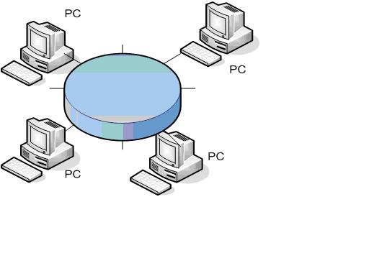
RING TOPOLOGY – Cont’d
Disadvantages
A faulty cable or workstation affects the entire network.
Troubleshooting is problematic.
It is difficult to maintain as changes made when reconfiguring a system
affects the entire network.

Slide 38
MESH TOPOLOGY
4. Mesh Topology
A mesh topology provides separate and distinct cable link among each of the systems on the network.
Unlike the star topology that provides separate cable link to the hub, the mesh offers straight line of communication among all the systems without any intermediary.
Going by physical connections, this topology is complex to design, but it offers a very simple logical connection because of its direct communication method.
The physical mesh topology is expensive to install and maintain. Having N number of workstations requires N x (N-I )/2 cables to connect them.
Advantages
There is enhanced fault tolerance.
It is easy to troubleshoot.

Slide 39
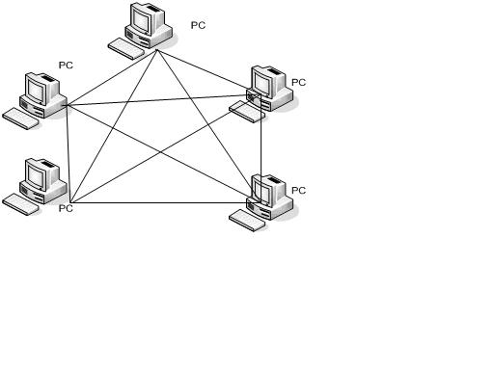
MESH TOPOLOGY
Disadvantages
It requires a lot of cable connections.
It is very expensive.
It is difficult to install.
It is difficult to maintain.

Slide 40
HYBRID TOPOLOGY
5. Hybrid Topology
This offers a hybrid or a mix of other topologies.
This has led to a concept that is referred to as Network Hybridization, which means heterogeneous mix of network components in terms of types and brands.
Thus we can have such variants like: Star-Bus Network and Star-Ring network which are just combinations of star, ring and bus topologies. The Internet obviously is a hybrid of all the topologies available.
Advantage
It offers the best features of each topology involved.
Disadvantage
It is very Complex (being a combination of two or more topologies)

Slide 41
PRACTICE QUESTIONS
What is Computer network? Distinguish between wired and wireless networks.
Distinguish between Peer to Peer and client/server networks stating the characteristics of each of them.
What are the factors generally considered in deciding on the type of network to adopt?
Write short notes on the following network categories:
LAN
MAN
WAN
Write short notes on the following network topologies:
BUS
Star
Ring
Mesh
Hybrid

Slide 42
Group Work 1
Make a write up with graphical illustration of the topology, requirements and problems associated with these types of network:
Group A: A wired LAN (Surname starting with A to D)
Group B: A Wireless LAN (Surname starting with O)
Group C: A wired WAN (Surname starting with E to N)
Group D: A wireless WAN (Surname starting with P to Z)
Submissions: Presentation slides and write-up in words
Submission date: June 11, 2021

